Slide 1
Design and Analysis of Algorithms CS345
Lecture 21
Polynomial time algorithms for Maximum Flow
(By Carefully choosing the augmenting paths in FF-algorithm)

Slide 2
Rounding of a matrix
A motivating application of
Max Flow

Slide 3




Integrality of max-flow
Theorem: Given a network $G$=($V$,$E$), and two vertices $s$,$t∈V$,
if edge capacities are integers, then there exists a maximum $s$-$t$flow $f$
which is “integral”.
$f\left(e\right)∈Z$for each $e∈E$
0.67
1
0.67
1
1
1
1
$$s$$
1
0
$$t$$
0.33
0
0.33
1
1

Slide 4

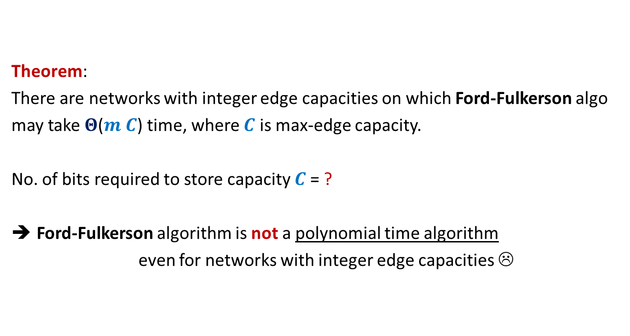

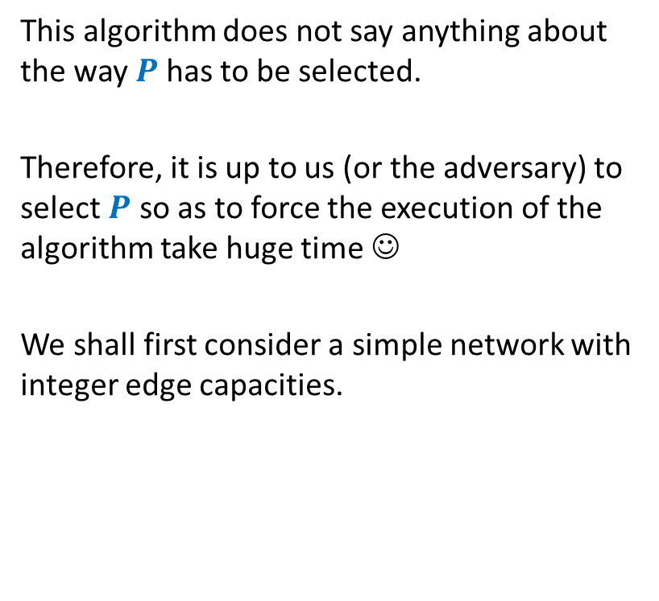


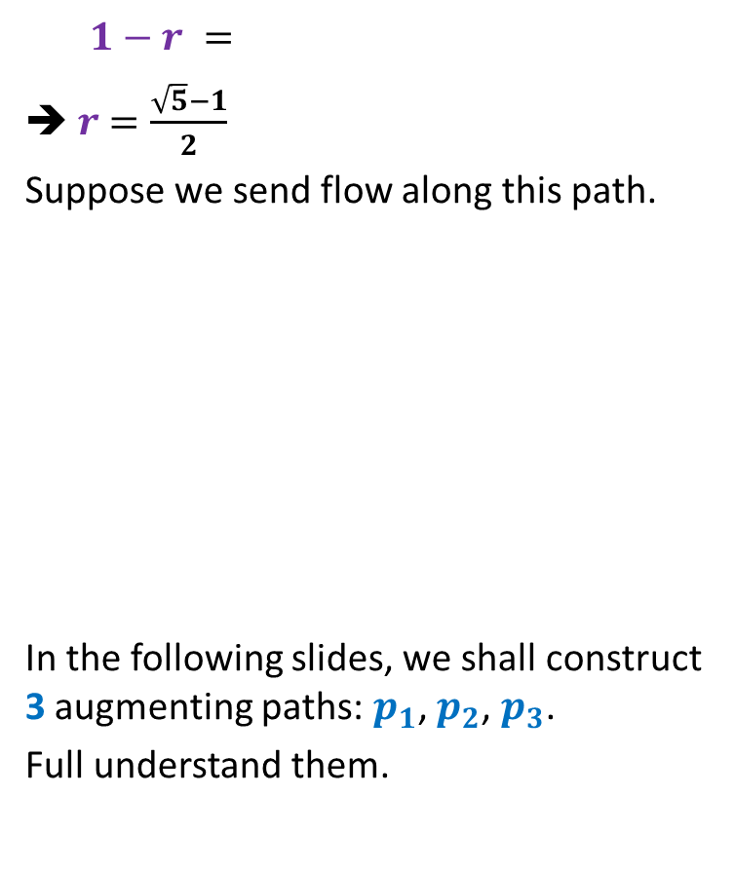

Rounding of a matrix
$$11$$
$$11.7$$
$$12$$
$$39$$ | $$19$$ | $$18$$ | $$30$$
$$37$$
$$15$$
$$20$$
$$34$$
$$11.7$$ | $$2.4$$ | $$4.3$$ | $$18.6$$
$$5.2$$ | $$6.1$$ | $$1.0$$ | $$2.7$$
$$6.7$$ | $$3.6$$ | $$9.1$$ | $$0.6$$
$$15.4$$ | $$6.9$$ | $$3.6$$ | $$8.1$$
$$12$$ | $$2$$ | $$4$$ | $$19$$
$$5$$ | $$6$$ | $$1$$ | $$3$$
$$7$$ | $$4$$ | $$9$$ | $$0$$
$$15$$ | $$7$$ | $$4$$ | $$8$$
Design an algorithm to round a $n×n$ matrix, if possible ?
Rounding always exists !
Rounding can be computed efficiently.
Using Max Flow ☺

Slide 5

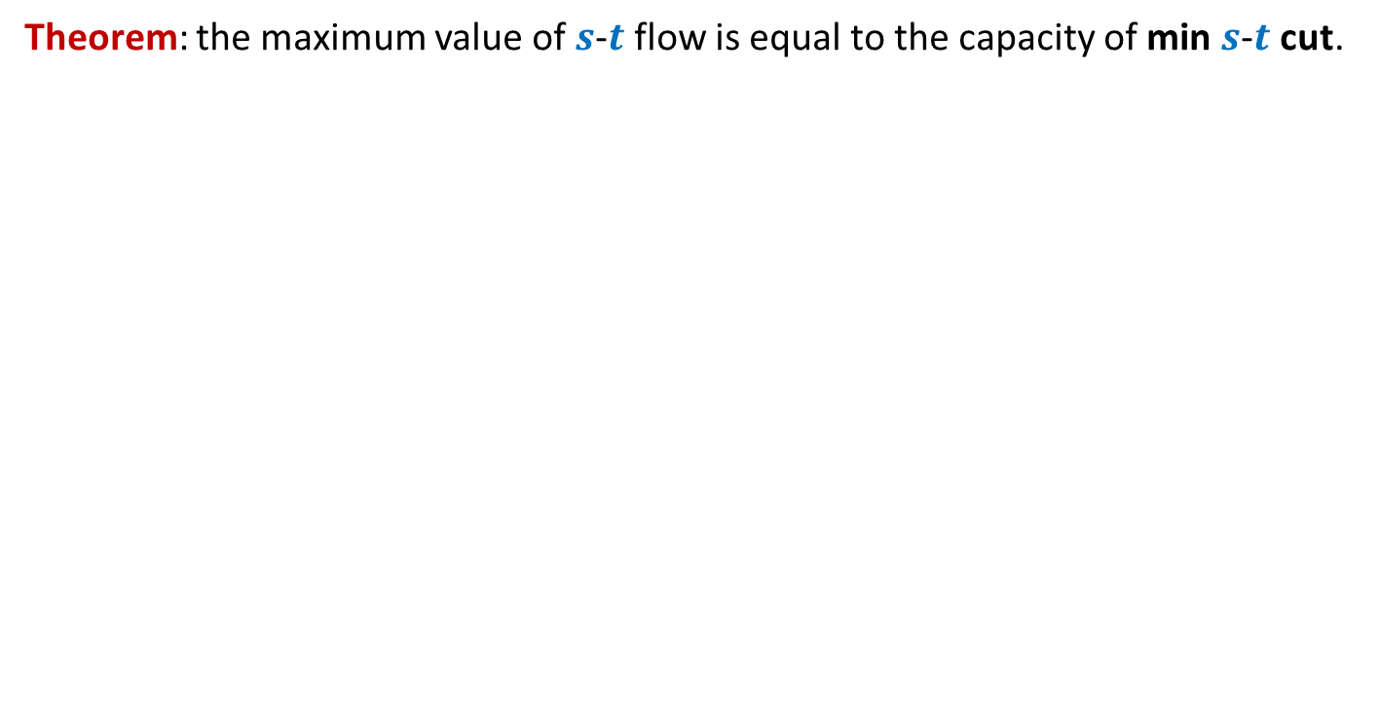
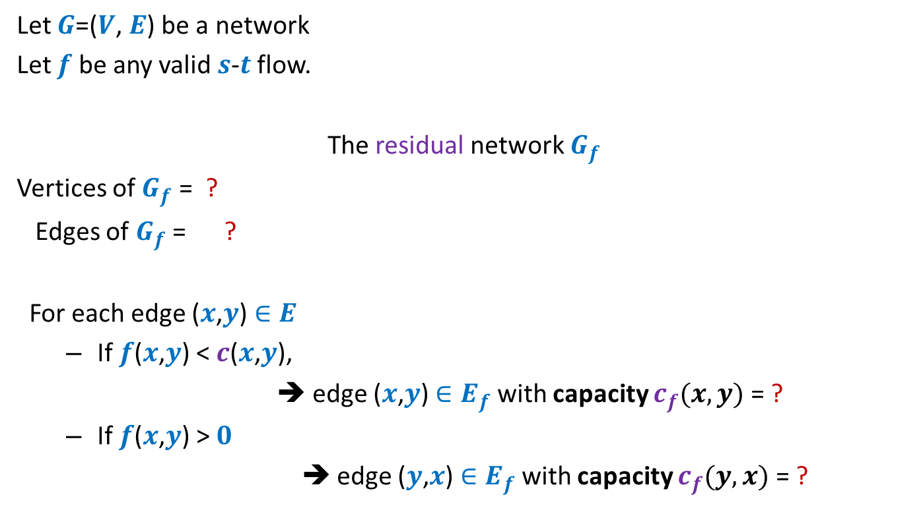
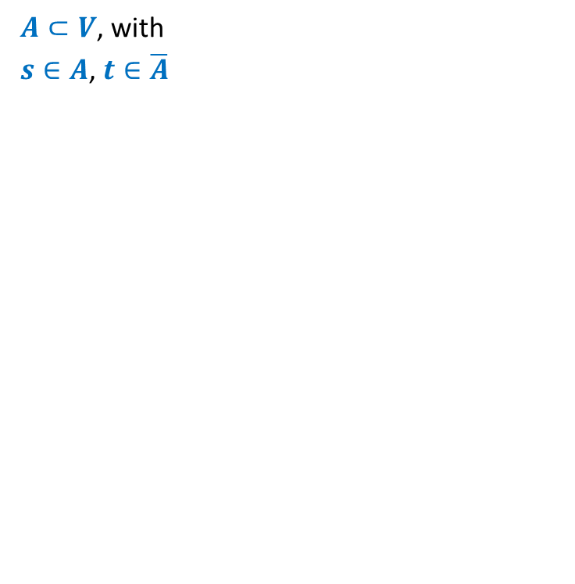






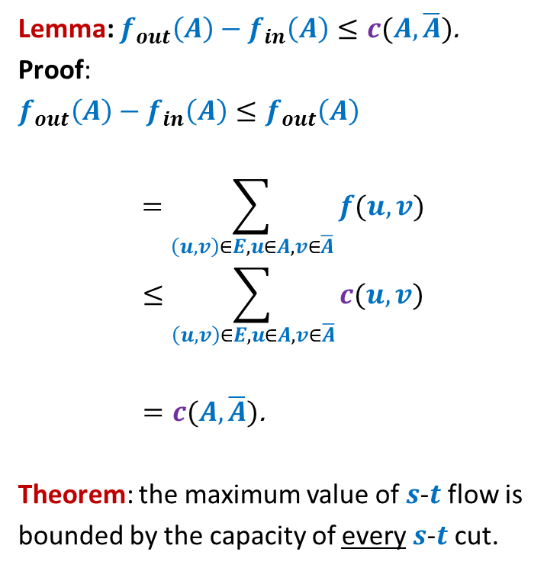







Rounding of a matrix
$$0$$
$$0.7$$
$$1$$
$$2$$ | $$2$$ | $$1$$ | $$2$$
rows
columns
$$2$$
$$1$$
$$2$$
$$2$$
$$0.7$$ | $$0.4$$ | $$0.3$$ | $$0.6$$
$$0.2$$ | $$0.1$$ | $$0.0$$ | $$0.7$$
$$0.7$$ | $$0.6$$ | $$0.1$$ | $$0.6$$
$$0.4$$ | $$0.9$$ | $$0.6$$ | $$0.1$$
$$1$$
$$0.2$$
$$2$$
$$2$$
$$1$$
$$0.1$$
$$2$$
$$1$$
$$0$$
$$2$$
$$0.0$$
$$1$$
$$0.7$$
$$1$$
$$2$$
$$2$$
Homework: Show that an integral max flow gives a solution to the matrix rounding problem.

Slide 6
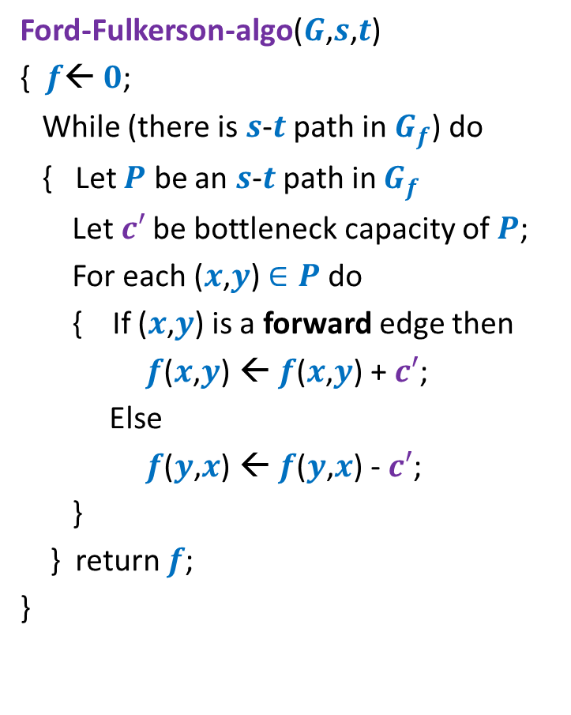
Ford Fulkerson algorithm
Ford-Fulkerson-algo($G$,$s$,$t$)
{ $f$← $0$;
While (there is $s$-$t$ path in $G_{f}$) do
{ Let $P$ be an $s$-$t$ path in $G_{f}$
Let$c′$ be bottleneck capacity of $P$;
For each ($x$,$y$) $∈P$ do
{ If ($x$,$y$) is a forward edge then
$f$($x$,$y$) ← $f$($x$,$y$) + $c′$;
Else
$f$($y$,$x$) ← $f$($y$,$x$) - $c′$;
}
} return $f$;
}
Polynomial time algorithm ?

Slide 7
Polynomial time algorithms for Max-Flow
A natural question: How to achieve polynomial running time ?
➔
A natural idea:
Select the path of maximum capacity.
select the paths in Ford-Fulkerson algorithm cleverly

Slide 8
Polynomial Time algorithms for max-flow
Algorithm 1 For Networks with integer capacities

Slide 9

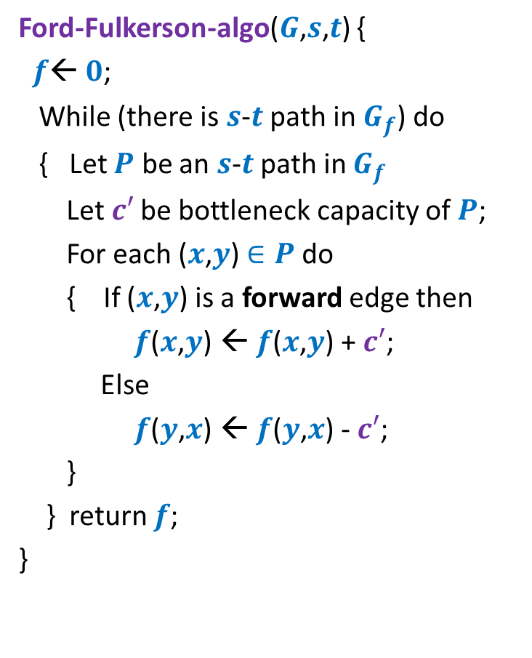

Algorithm 1
Algorithm-1($G$,$s$,$t$) {
Ford-Fulkerson-algo($G$,$s$,$t$) {
$f$← $0$;
While (there is $s$-$t$ path in $G_{f}$) do
{ Let $P$ be an $s$-$t$ path in $G_{f}$
Let$c′$ be bottleneck capacity of $P$;
For each ($x$,$y$) $∈P$ do
{ If ($x$,$y$) is a forward edge then
$f$($x$,$y$) ← $f$($x$,$y$) + $c′$;
Else
$f$($y$,$x$) ← $f$($y$,$x$) - $c′$;
}
} return $f$;
}
In order to show that this algorithm takes polynomial time, we shall reformulate this algorithm.
This will help in the analysis as well.
Let $P$ be the max-capacity $s$-$t$ path in $G_{f}$;

Slide 10

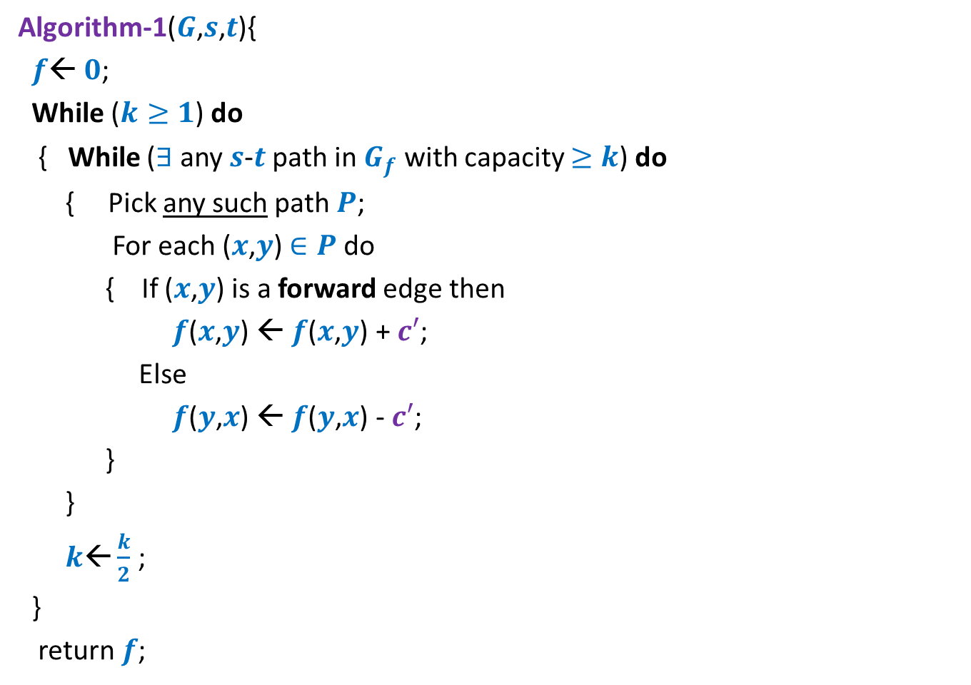


Algorithm 1
Algorithm-1($G$,$s$,$t$){
$f$← $0$;
While ($k≥1$) do
{ While ($∃$any $s$-$t$ path in $G_{f}$ with capacity $≥k$) do
{ Pick any such path $P$;
For each ($x$,$y$) $∈P$ do
{ If ($x$,$y$) is a forward edge then
$f$($x$,$y$) ← $f$($x$,$y$) + $c′$;
Else
$f$($y$,$x$) ← $f$($y$,$x$) - $c′$;
}
}
$k\text{←}\frac{k}{2}$ ;
}
return $f$;
$k$← max-capacity($E$);
$\log_{2} c_{max}$ iterations
How many iterations of this loop for a given $k$?

Slide 11








Consider the flow $f$ when there is no $s$-$t$ path in $G_{f}$ with capacity $≥k$.
$A$: set of vertices reachable from $s$ with edges of capacity $≥k$in $G_{f}$
Question: How much flow is being carried on edges of cut$(A,\overline{A})$ at this stage?
$$s$$
$$t$$
$$s$$
$$t$$
$$A$$
$$\overline{A}$$
$$A$$
$$\overline{A}$$
$$G$$
$$G_{f}$$

Slide 12


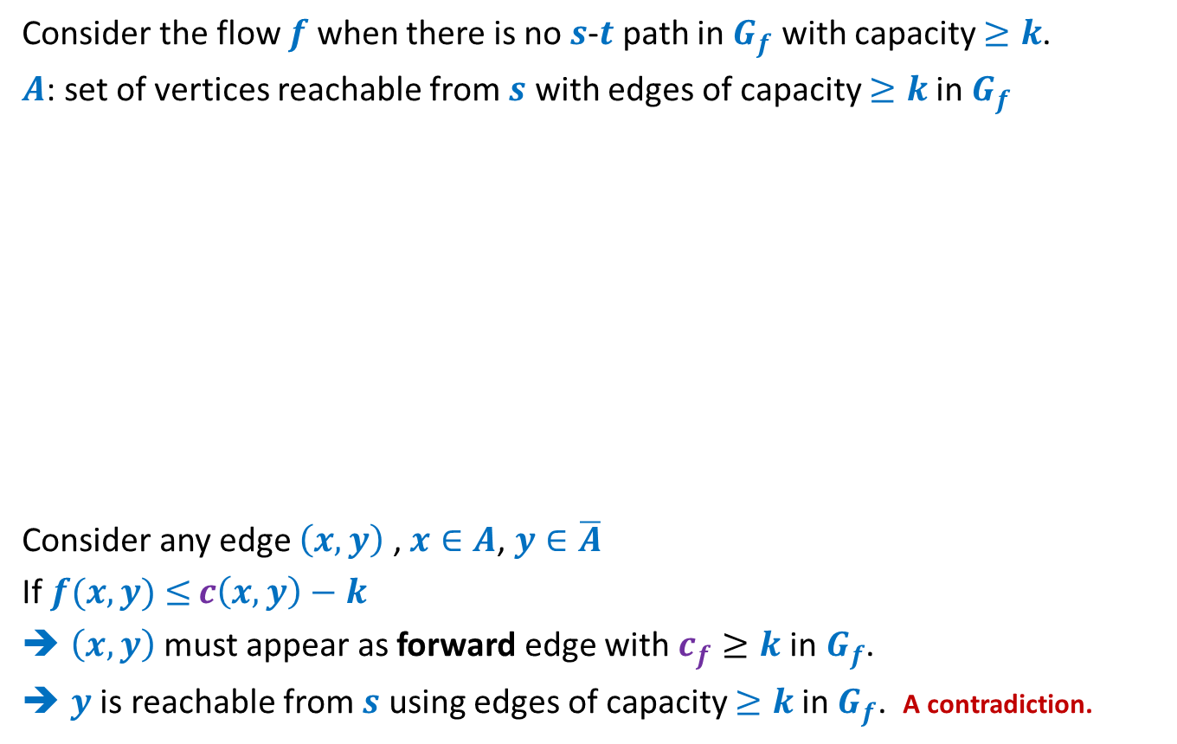

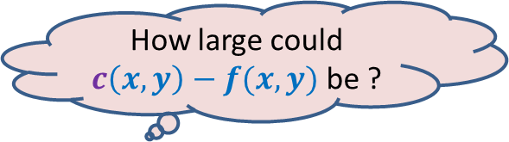

Consider the flow $f$ when there is no $s$-$t$ path in $G_{f}$ with capacity $≥k$.
$A$: set of vertices reachable from $s$ with edges of capacity $≥k$in $G_{f}$
Consider any edge $\left(x,y\right)$ , $x∈A$, $y∈\overline{A}$
If $f(x,y)$ $≤$ $c\left(x,y\right)−k$
$\left(x,y\right)$ must appear as forward edge with $c_{f}≥k$in$G_{f}$.
$y$ is reachable from $s$ using edges of capacity $≥k$in $G_{f}$. A contradiction.
$$x$$
$$x$$
$$s$$
$$y$$
$$t$$
$$s$$
$$y$$
$$t$$
$$A$$
$$\overline{A}$$
$$A$$
$$\overline{A}$$
$$G$$
$$G_{f}$$
How large could $c\left(x,y\right)−f(x,y)$ be ?

Slide 13


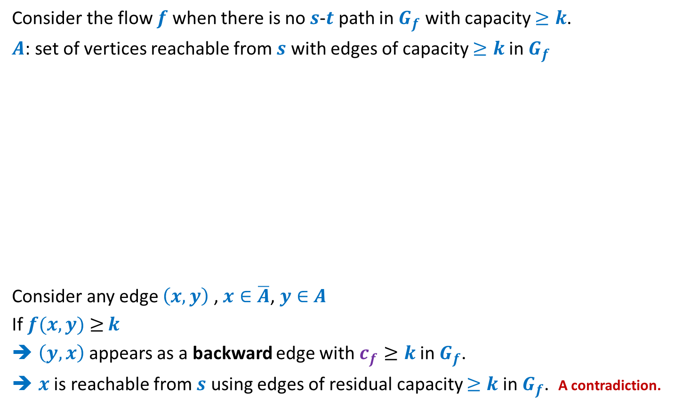



Consider the flow $f$ when there is no $s$-$t$ path in $G_{f}$ with capacity $≥k$.
$A$: set of vertices reachable from $s$ with edges of capacity $≥k$in $G_{f}$
Consider any edge $\left(x,y\right)$ , $x∈\overline{A}$, $y∈$ $A$
If $f(x,y)$ $≥$ $k$
$\left(y,x\right)$appears as a backward edge with $c_{f}≥k$in$G_{f}$.
$x$ is reachable from $s$ using edges of residual capacity $≥k$in $G_{f}$. A contradiction.
$$s$$
$$x$$
$$s$$
$$x$$
$$t$$
$$t$$
$$y$$
$$y$$
$$A$$
$$\overline{A}$$
$$A$$
$$\overline{A}$$
$$G$$
$$G_{f}$$
How large could $f(x,y)$ be ?

Slide 14

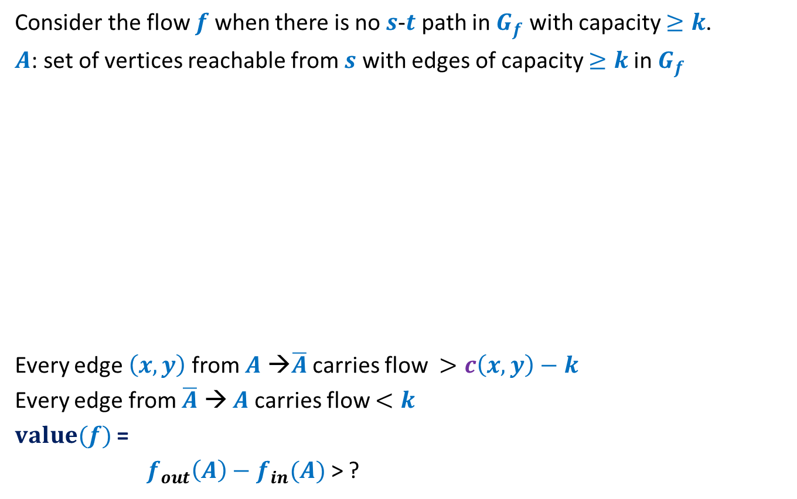

Consider the flow $f$ when there is no $s$-$t$ path in $G_{f}$ with capacity $≥k$.
$A$: set of vertices reachable from $s$ with edges of capacity $≥k$in $G_{f}$
Every edge $\left(x,y\right)$from $A$ →$\overline{A}$ carries flow $>c\left(x,y\right)−k$
Every edge from $\overline{A}$ → $A$carries flow $<k$
$value(f)$ =
$f_{out}\left(A\right)−f_{in}(A)$ > ?
$$s$$
$$t$$
$$s$$
$$t$$
$$A$$
$$\overline{A}$$
$$A$$
$$\overline{A}$$
$$G$$
$$G_{f}$$
$$c\left(A,\overline{A}\right)−mk$$
?
> $f_{max}−mk$

Slide 15

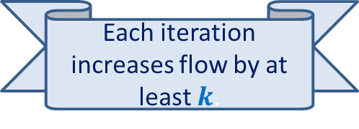
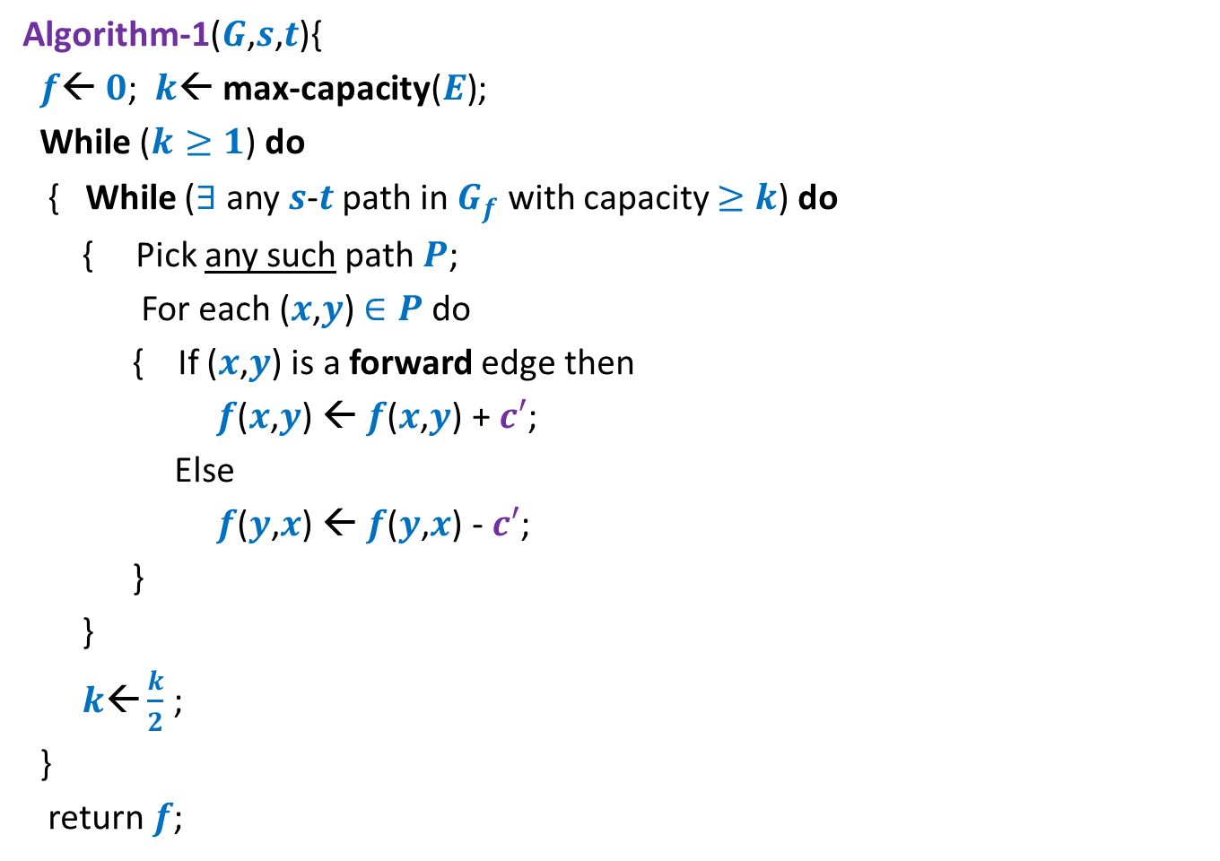
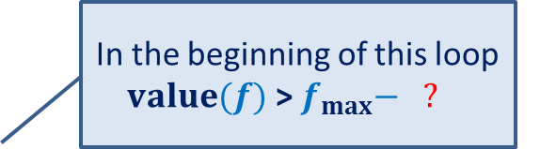
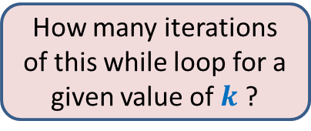
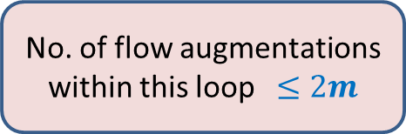
Algorithm 1
Algorithm-1($G$,$s$,$t$){
$f$← $0$; $k$← max-capacity($E$);
While ($k≥1$) do
{ While ($∃$any $s$-$t$ path in $G_{f}$ with capacity $≥k$) do
{ Pick any such path $P$;
For each ($x$,$y$) $∈P$ do
{ If ($x$,$y$) is a forward edge then
$f$($x$,$y$) ← $f$($x$,$y$) + $c′$;
Else
$f$($y$,$x$) ← $f$($y$,$x$) - $c′$;
}
}
$k\text{←}\frac{k}{2}$ ;
}
return $f$;
In the beginning of this loop
$value(f)$ > $f_{max}− ?$
$\log_{2} c_{max}$ iterations
$$2mk$$
No. of flow augmentations within this loop $≤2m$
How many iterations of this while loop for a given value of $k$ ?
Each iteration increases flow by at least $k$.

Slide 16
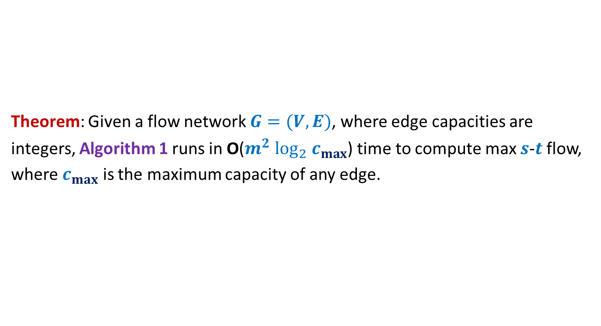
Algorithm 1
Theorem: Given a flow network $G=(V,E)$, where edge capacities are
integers, Algorithm 1 runs in O($m^{2} \log_{2} c_{max}$) time to compute max $s$-$t$ flow,
where $c_{max}$ is the maximum capacity of any edge.

Slide 17
Ford Fulkerson algorithm
Worst case running time on networks
with real edge weights

Slide 18


A non-terminating example for networks with real edge weights
$$G$$
$$x$$
Max-flow = 5
$1−r =$
➔ $r$ $=\frac{\sqrt{5}−1}{2}$
There exists an infinite sequence of augmenting paths such that even asymptotically, the flow will be less than 5.
$$r^{2}$$
2
1
2
$$u$$
$$s$$
2
$$t$$
1
2
$$v$$
2
2
$$r$$
$$y$$

Slide 19

Polynomial Time algorithms for max-flow
Algorithm 2 For Networks with edge capacities $∈R^{+}$

Slide 20
Ford Fulkerson Algorithm
Ford-Fulkerson-algo($G$,$s$,$t$) {
$f$← $0$;
While (there is $s$-$t$ path in $G_{f}$) do
{ Let $P$ be an $s$-$t$ path in $G_{f}$
Let$c′$ be bottleneck capacity of $P$;
For each ($x$,$y$) $∈P$ do
{ If ($x$,$y$) is a forward edge then
$f$($x$,$y$) ← $f$($x$,$y$) + $c′$;
Else
$f$($y$,$x$) ← $f$($y$,$x$) - $c′$;
}
} return $f$;
}
Observation:
In each iteration,
at least one edge disappears from $G_{f}$.
The new algorithm will emerge from
a better understanding of
disappearance/re-appearance of an edge.
But it may appear in $G_{f}$ again.

Slide 21

Algorithm 2
Ford-Fulkerson-algo($G$,$s$,$t$) {
$f$← $0$;
While (there is $s$-$t$ path in $G_{f}$) do
{ Let $P$ be an $s$-$t$ path in $G_{f}$
Let$c′$ be bottleneck capacity of $P$;
For each ($x$,$y$) $∈P$ do
{ If ($x$,$y$) is a forward edge then
$f$($x$,$y$) ← $f$($x$,$y$) + $c′$;
Else
$f$($y$,$x$) ← $f$($y$,$x$) - $c′$;
}
} return $f$;
}
Algorithm-2($G$,$s$,$t$) {
In each iteration, at least one edge disappears from $G_{f}$.
This algorithm ensures that an edge can disappear and re-appear O($n$) times.
Let $P$ be the shortest $s$-$t$ path in $G_{f}$;
How to modify the FF algorithm so that the number of times an edge disappears has a polynomial bound ?

Slide 22


Algorithm 2
Ford-Fulkerson-algo($G$,$s$,$t$) {
$f$← $0$;
While (there is $s$-$t$ path in $G_{f}$) do
{ Let $P$ be an $s$-$t$ path in $G_{f}$
Let$c′$ be bottleneck capacity of $P$;
For each ($x$,$y$) $∈P$ do
{ If ($x$,$y$) is a forward edge then
$f$($x$,$y$) ← $f$($x$,$y$) + $c′$;
Else
$f$($y$,$x$) ← $f$($y$,$x$) - $c′$;
}
} return $f$;
}
Algorithm-2($G$,$s$,$t$) {
Ponder over it before coming to the next class ☺
Let $P$ be the shortest $s$-$t$ path in $G_{f}$;

Slide 23
Ford Fulkerson algorithm
Worst case running time on networks
with real edge weights

Slide 24

A non-terminating example for networks with real edge weights
$$G$$
$$x$$
Max-flow = 5
$1−r =$
➔ $r$ $=\frac{\sqrt{5}−1}{2}$
Suppose we send flow along this path.
In the following slides, we shall construct 3 augmenting paths: $p_{1}$, $p_{2}$, $p_{3}$.
$$r^{2}$$
2
1
2
$$u$$
$$s$$
2
What will be the residual capacity of ($u,x$),($y,v$),($u,v$) in the residual network at stage ?
$$t$$
1
2
$$v$$
2
2
$$r$$
[$r^{0}$, $r^{1}$, $0$]
$$y$$

Slide 25


A non-terminating example for networks with real edge weights
$$G$$
$$x$$
Max-flow = 5
$1−r =$
➔ $r$ $=\frac{\sqrt{5}−1}{2}$
$$r^{2}$$
$$u$$
$$s$$
$$t$$
This is $p_{1}$.
$$v$$
$$y$$

Slide 26

A non-terminating example for networks with real edge weights
$$G$$
$$x$$
Max-flow = 5
$1−r =$
➔ $r$ $=\frac{\sqrt{5}−1}{2}$
$$r^{2}$$
$$u$$
$$s$$
$$t$$
This is $p_{2}$.
$$v$$
$$y$$

Slide 27
A non-terminating example for networks with real edge weights
$$G$$
$$x$$
Max-flow = 5
$1−r =$
$r$ $=\frac{\sqrt{5}−1}{2}$
Suppose after stage I, we select the next 4 augmenting paths as $p_{1}$, $p_{2}$, $p_{1}$, $p_{3}$.
Repeat sequence <$p_{1}$, $p_{2}$, $p_{1}$, $p_{3}$> infinitely
$$r^{2}$$
This is $p_{3}$.
$$u$$
$$s$$
$$t$$
What will be the residual capacity of ($u,x$),($y,v$),($u,v$) in $G_{f}$ at this stage ?
$$v$$
$$y$$
[$r^{2}$, $r^{3}$, $0$]
Make right inferences now ☺

Slide 28
A non-terminating example for networks with real edge weights
$$G$$
$$x$$
Max-flow = 5
$1−r =$
➔ $r$ $=\frac{\sqrt{5}−1}{2}$
Homework:
Make inference to show that in limits, the flow will reach $1+2\sum_{i=1}{r^{i}}$
$=3+2r$
< 5
$$r^{2}$$
2
1
2
$$u$$
$$s$$
2
$$t$$
1
2
$$v$$
2
2
$$r$$
$$y$$

Slide 29

Theorem:
There exists a network with 6 nodes and 9 edges and capacities ${∈R}^{+}$on which Ford Fulkerson may never terminate !

